Slide 1

We speak about these things in words not taught by human wisdom but by the Spirit, interpreting spiritual things to spiritual people (1 Cor. 2:13).
All Scripture taken from the English Unlocked Literal Bible (ULB), ©2017, 2022 Wycliffe Associates, Available at https://bibleineverylanguage.org/translations, licensed under the Creative Commons Attribution-ShareAlike 4.0 International License.
The English ULB is based on the unfoldingWord® Literal Text, CC BY-SA 4.0. The original work of the unfoldingWord® Literal Text is available at https://unfoldingword.bible/ult/.
Spiritual Terms Check

Slide 2
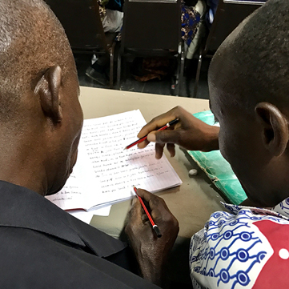
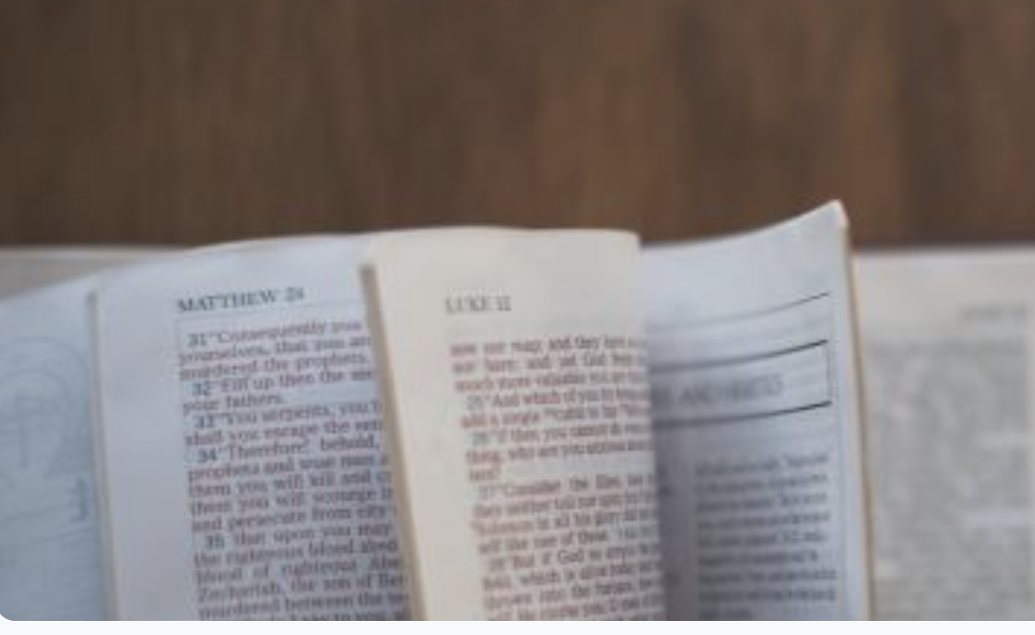
In Step 7, key words were chosen for each chapter.
Now an assigned list of terms will be evaluated across the whole New Testament.

Slide 3
What kinds of terms?
Abstract meaning
Spiritual
meaning
tree
adoption
flesh

Slide 4
?
Why check words across the whole New Testament?
Different translators
Same
words?

Slide 5
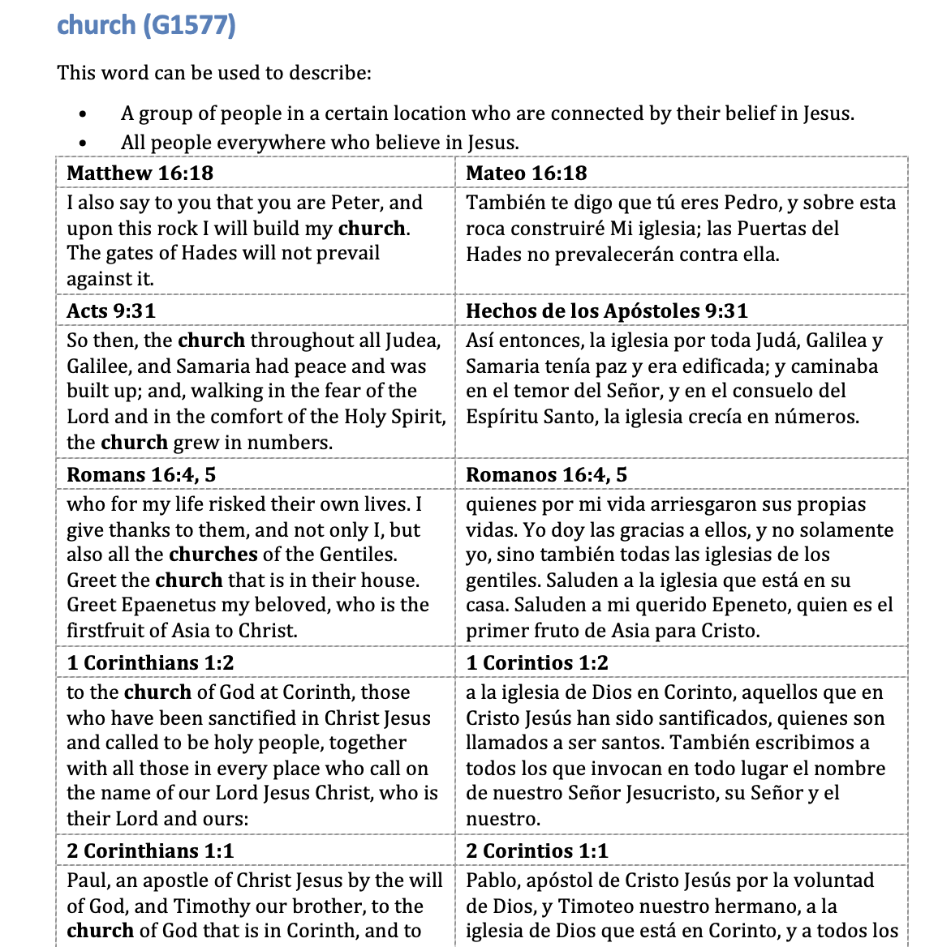



Slide 6
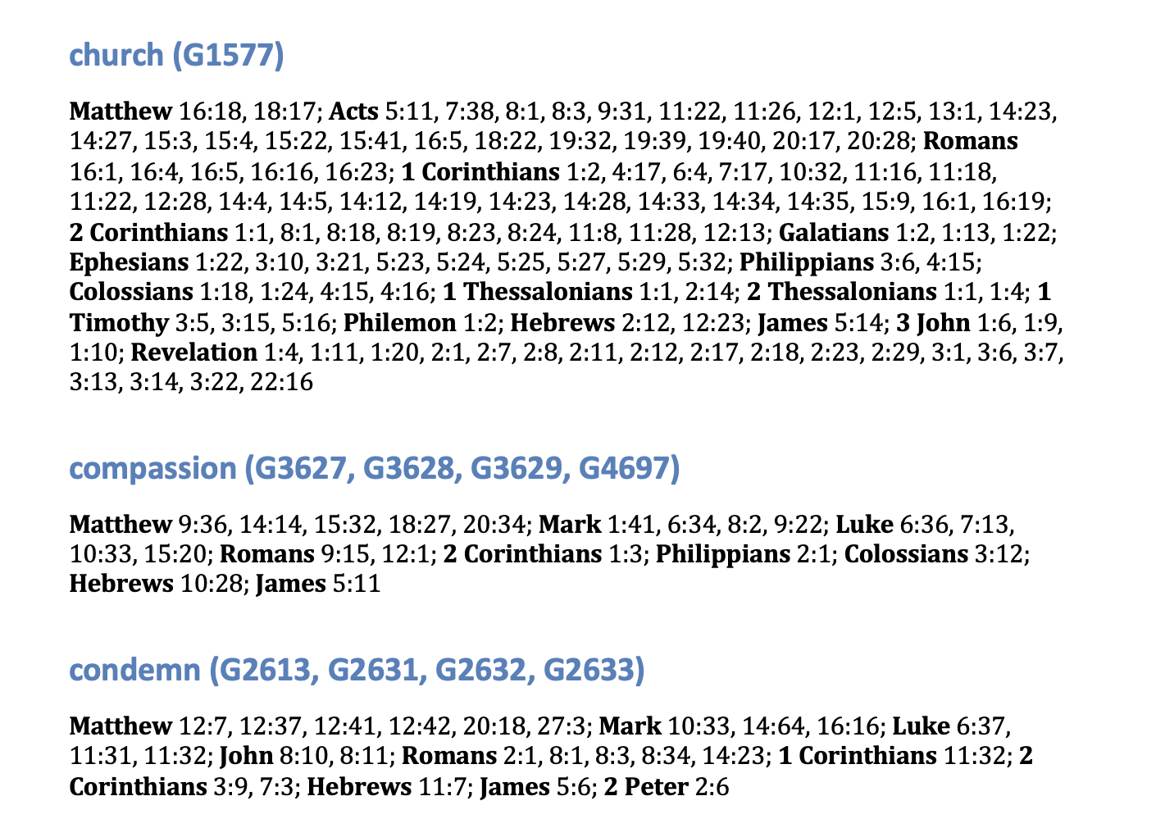

Slide 7
Try it

Slide 8
?
Consistency?
Correct meanings?
Changes?

